Slide 1
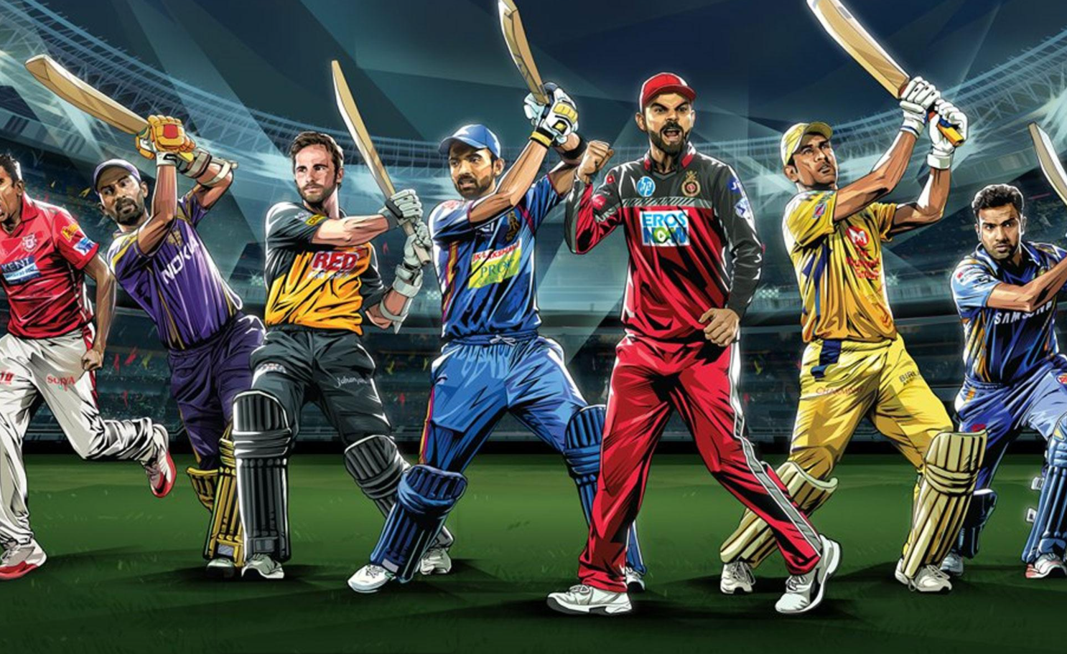

Slide 2

DATA VISUALISATION
MADE BY:- K.G.SAMPRIT

Slide 3
Objective
To create an interactive dashboard that highlights some of the important statistics of the IPL over the year 2008-2017.

Slide 4
Problem Statement
As a data Analyst at IFP, a nationally recognized news agency, the sports editor of the agency has approached to build an interactive Tableau Dashboard of IPL statistics over the years since its inception in order to create an infographic for a newsletter that their team is working on.
For this newsletter, in some cases, they will use the visual representations you have created in Tableau directly for their infographic, and in a few other cases, they will use important statistics after trying out the different filters and customizations that you have provided for interactivity.

Slide 5
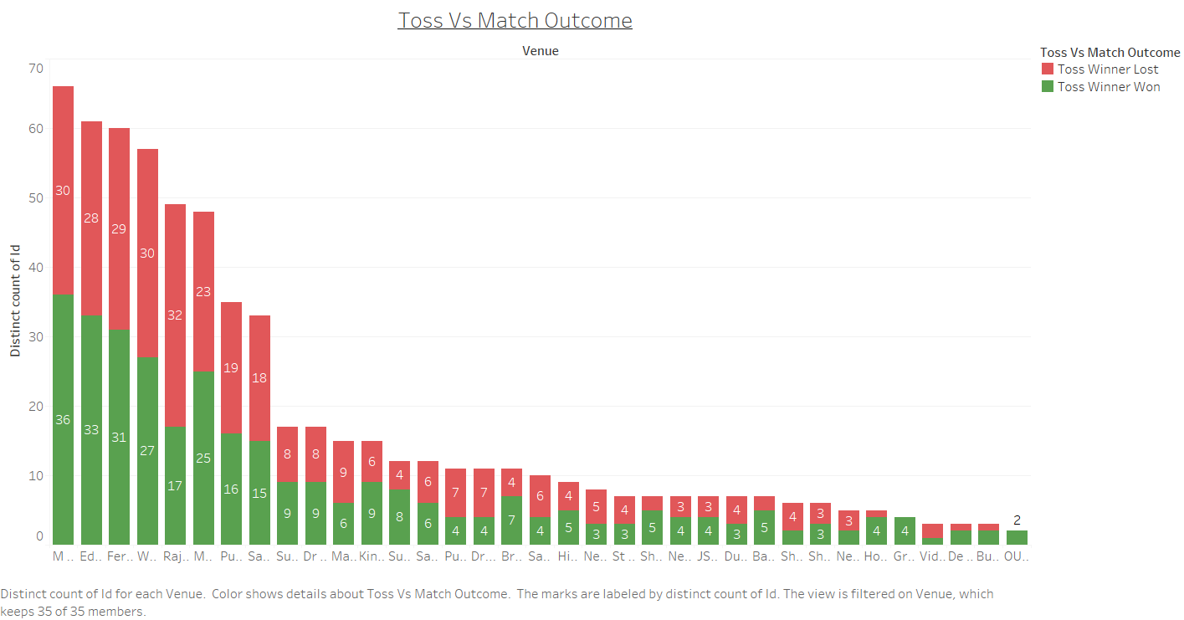

Slide 6
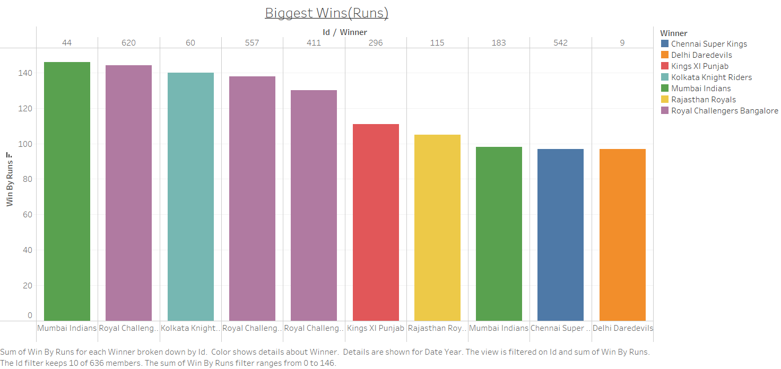

Slide 7
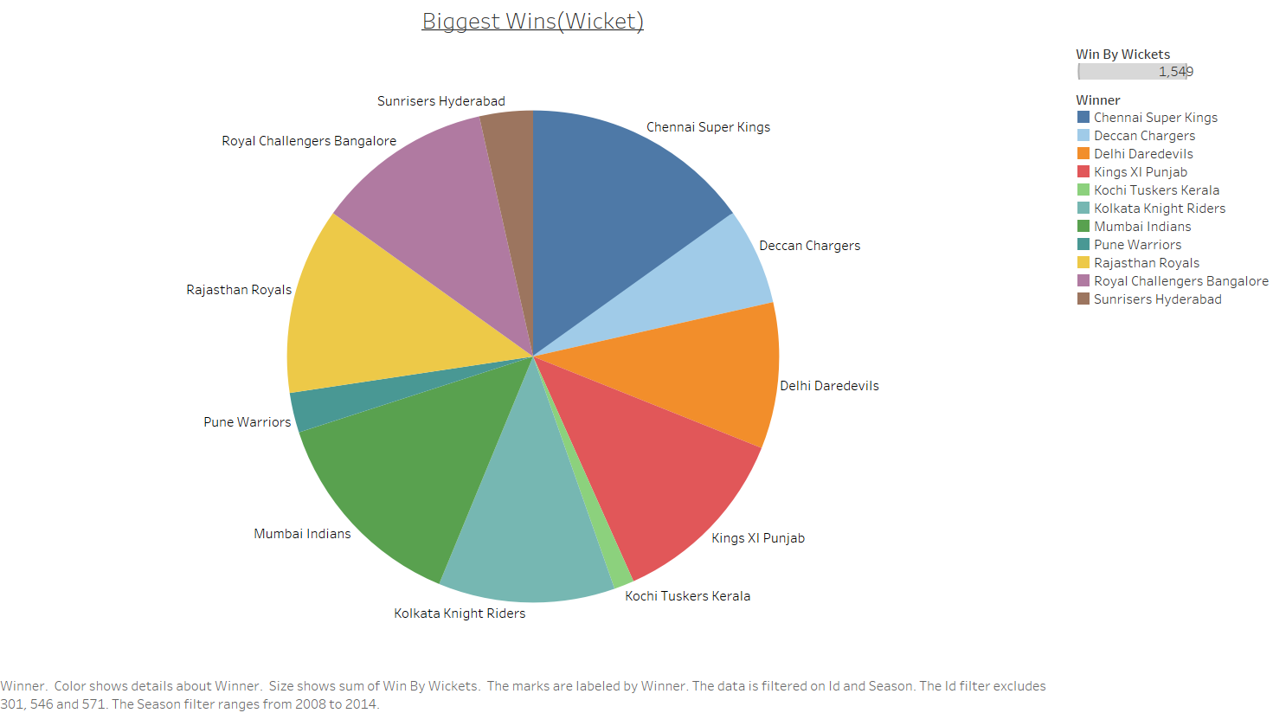

Slide 8
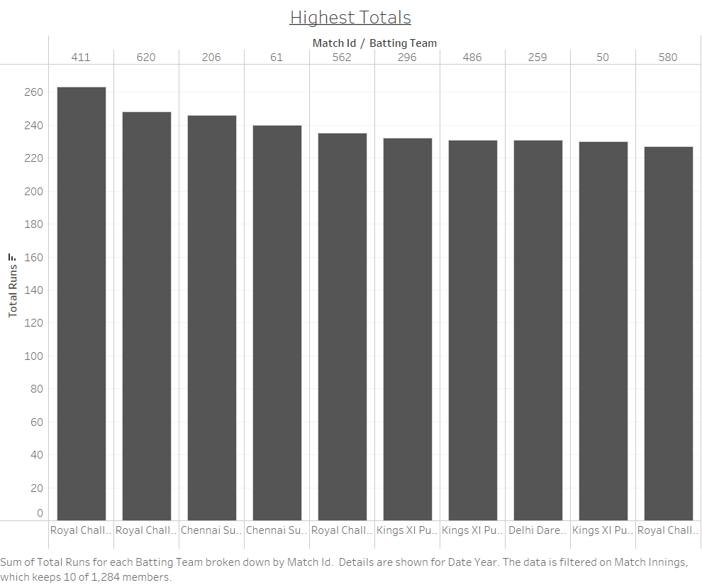

Slide 9
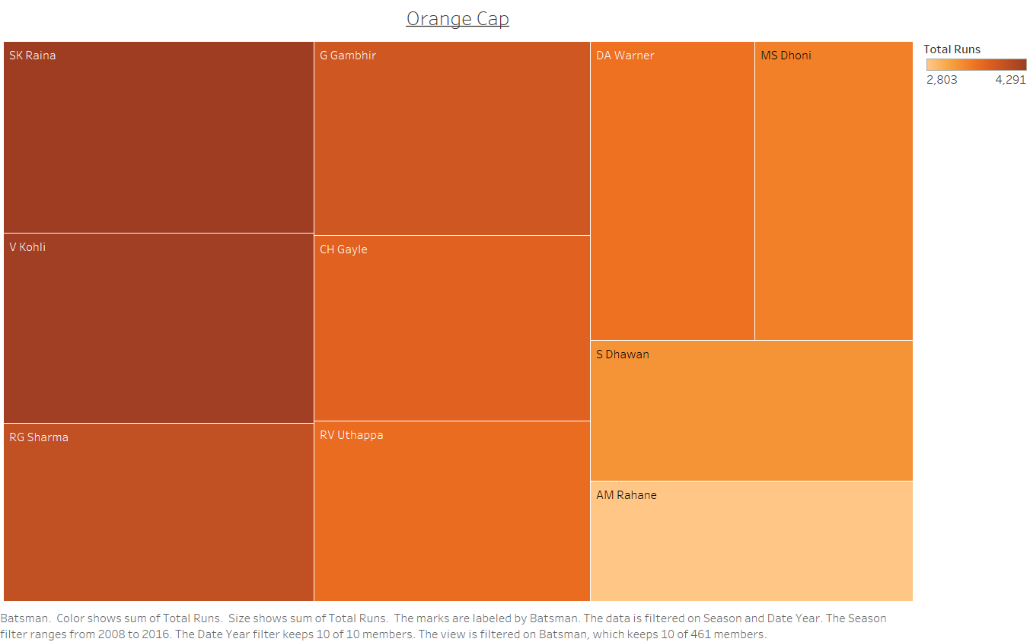

Slide 10
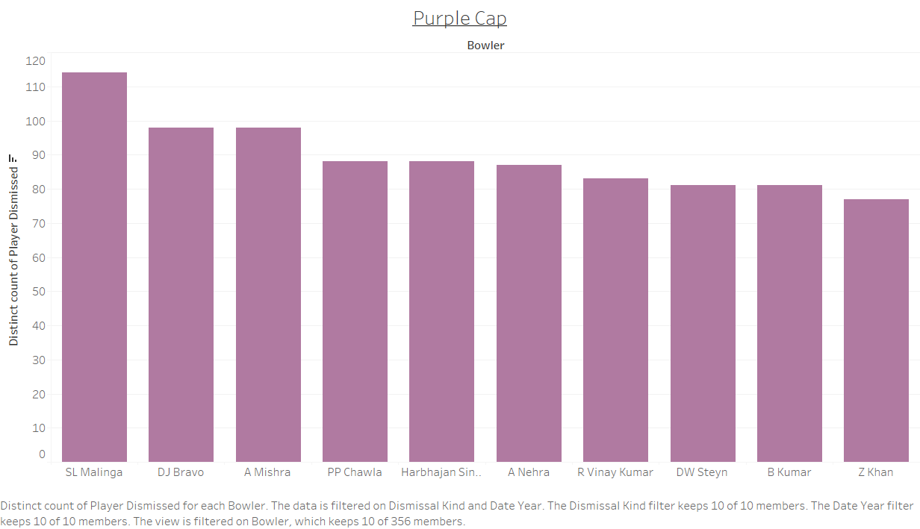

Slide 11
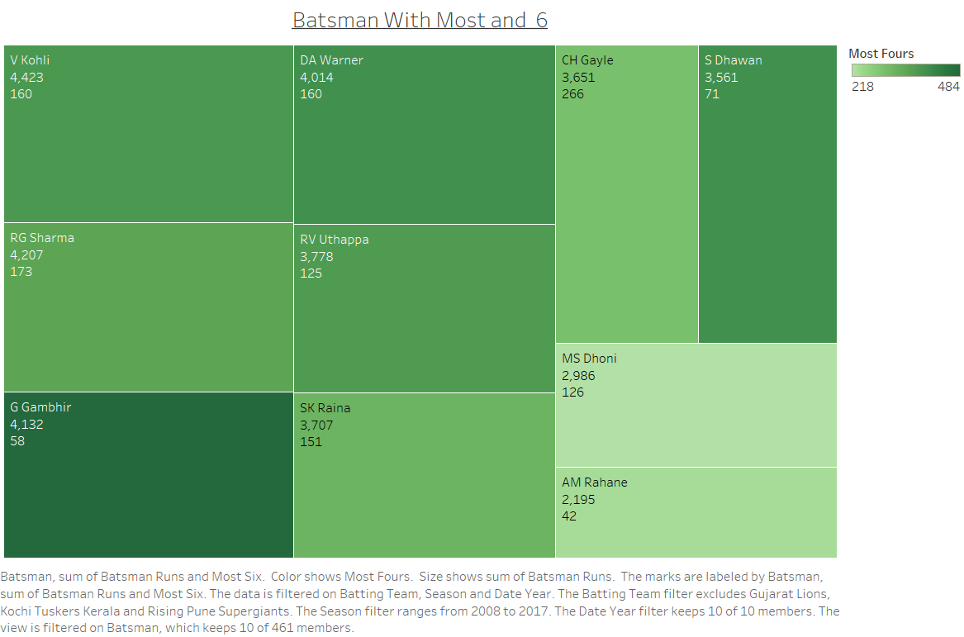

Slide 12
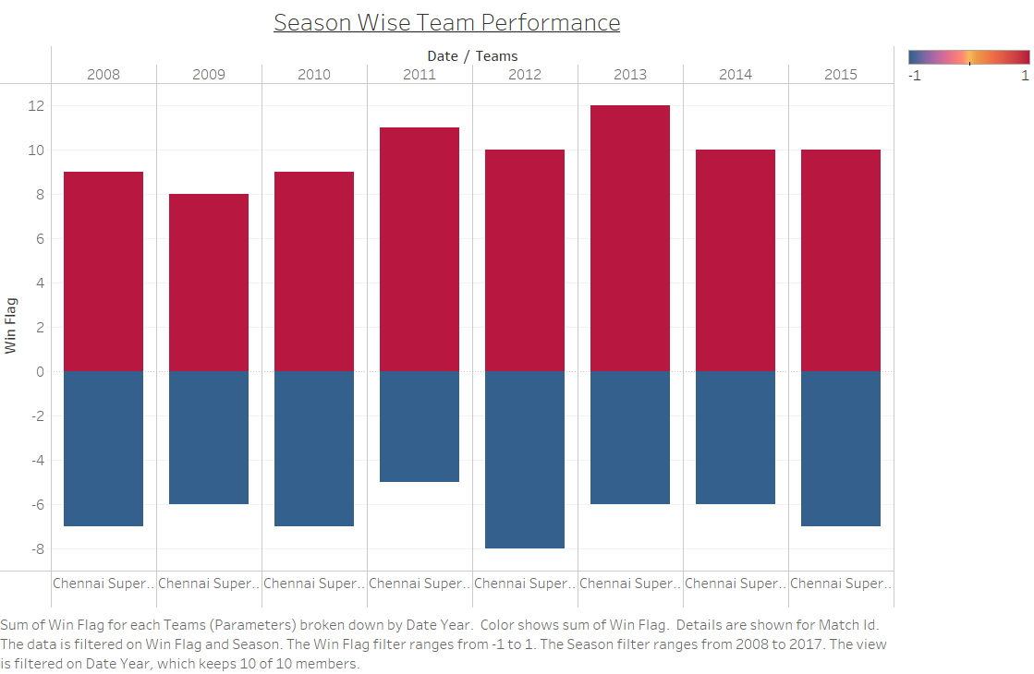

Slide 13
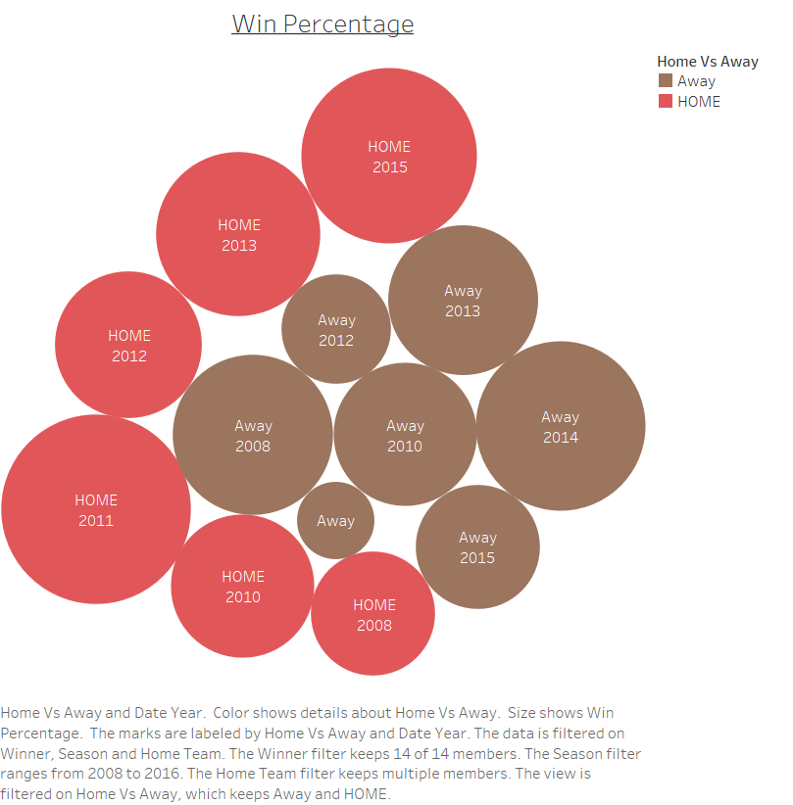

Slide 14
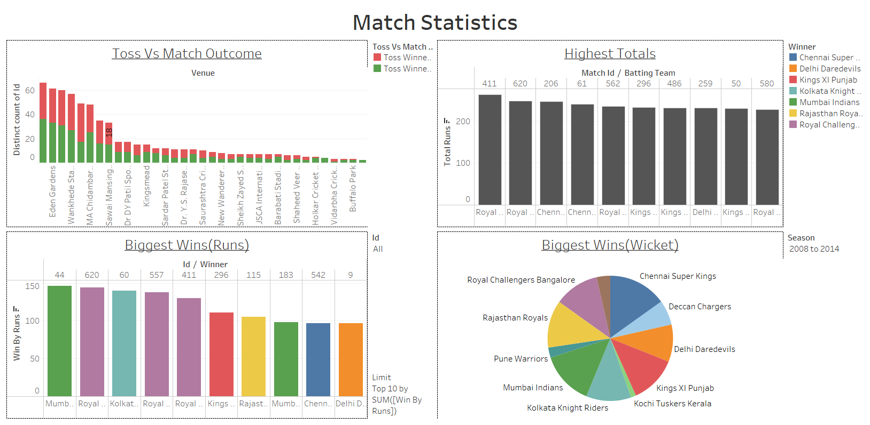

Slide 15
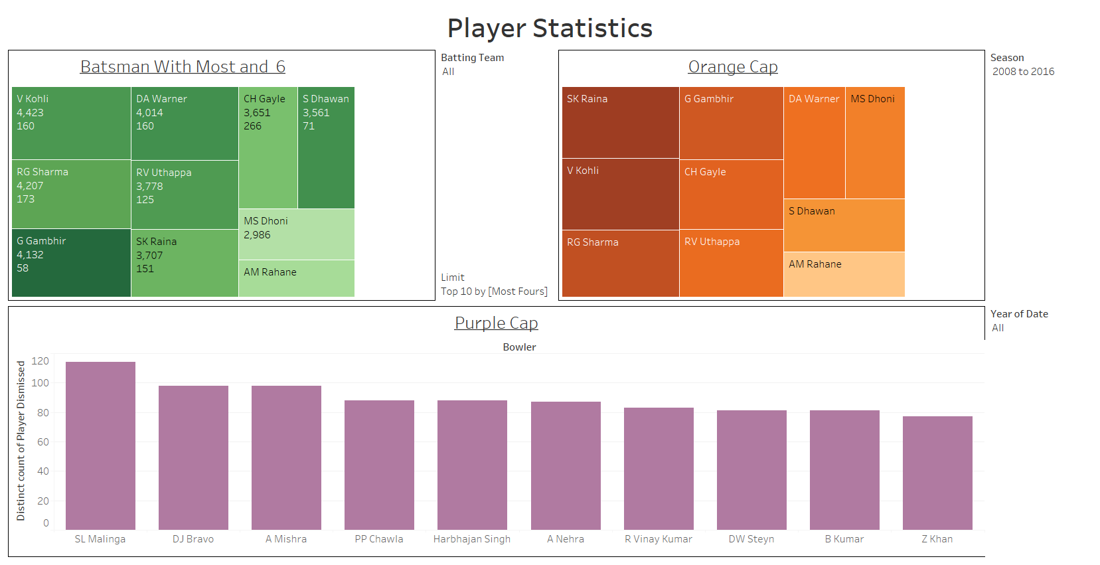

Slide 16
